Slide 1
Capstone Project - Final Presentation Predicting the behaviour of Customer towards loyalty program Project Team Ankit Mathur Rinesh Ranjan Vardharajan G P Apurv Salunke Raghul Sharan Project Mentor Mr. Ankush Bansal

Slide 2
Problem Statement
A analytical company named XYZ regularly helps its merchants understand their data better by providing machine learning and analytics consulting. ABC is an established Brick & Mortar retailer that frequently conducts marketing campaigns for its diverse product range. As a merchant of XYZ, they have sought XYZ to assist them in their discount marketing process. ABC’s promotions are shared across various channels which includes email, notifications, etc. A number of these campaigns include coupon discounts that are offered for a specific product/range of products.
The retailer would like the ability to predict whether customers redeem the coupons received across channels, which will enable the retailer’s marketing team to accurately design coupon construct, and develop more precise and targeted marketing strategies.

Slide 3
DATA DICTIONARY
Data Sources | Description
1.train.csv | This data source contains the coupons offered to customers under the 18 campaigns.
2.customer_transaction_data.csv | This data source contains the campaign information for 28 campaigns.
3.coupon_item_mapping.csv | This data source has the mapping of coupon and items valid for discount under that coupon.
4.item_data.csv | This data source contains the transaction data for all customers for duration of campaigns in the train data.
5.customer_transaction_data | This data source contains item information for each item sold by the retailer.

Slide 4
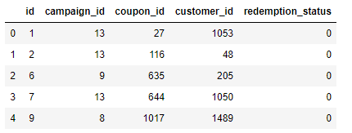
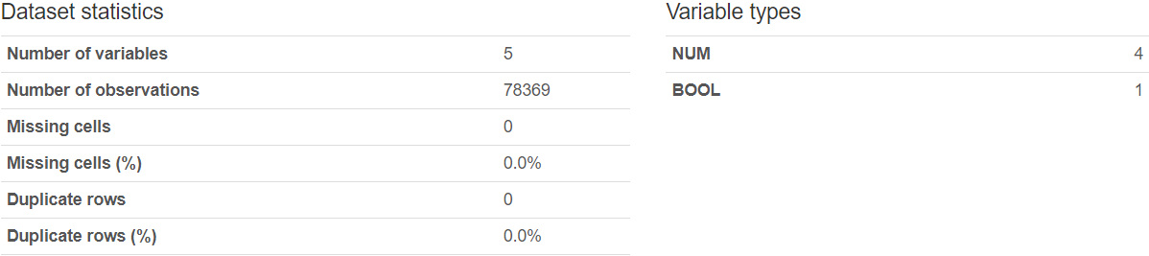
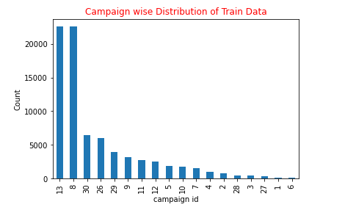
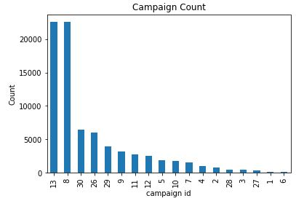
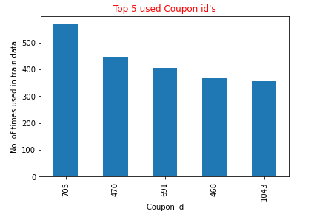
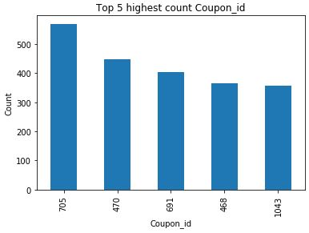
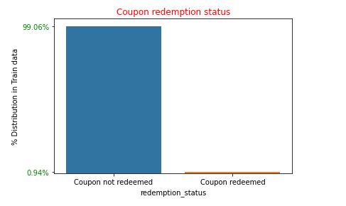
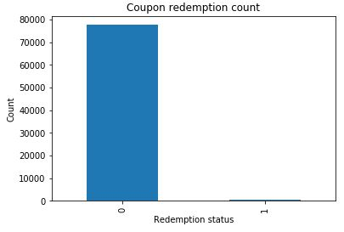
Exploratory data analysis
Train data
Univariate Analysis

Slide 5
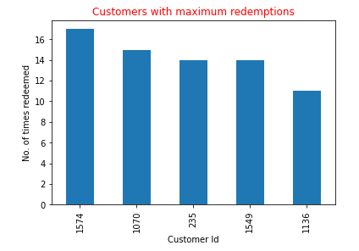
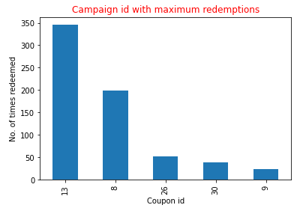
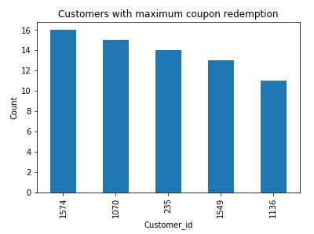
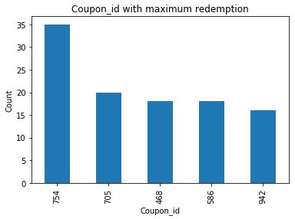
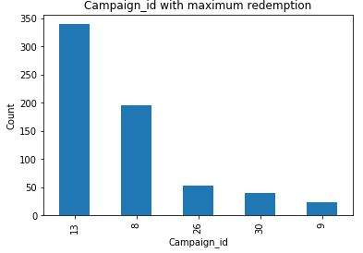
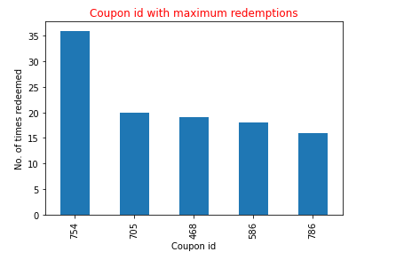
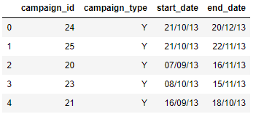
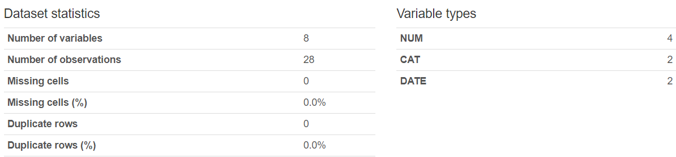
2. Campaign data

Slide 6
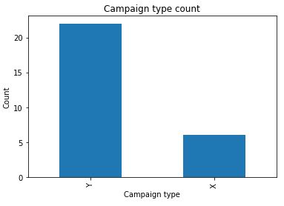
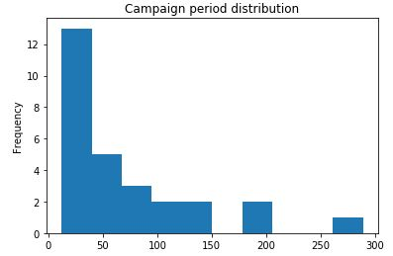
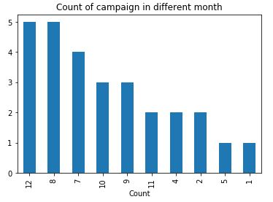
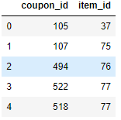
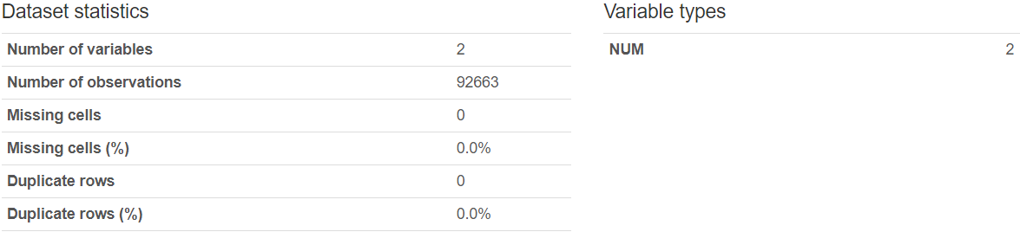
Univariate Analysis
3. Coupon item mapping data

Slide 7
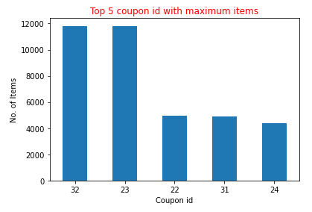
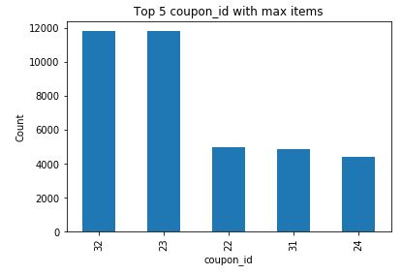
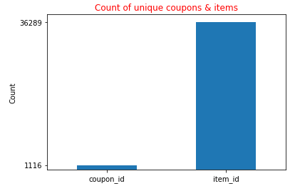
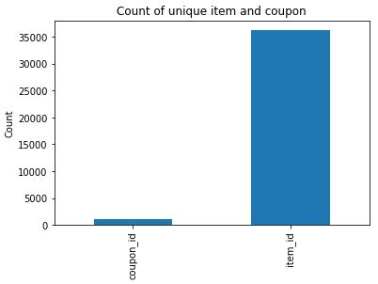
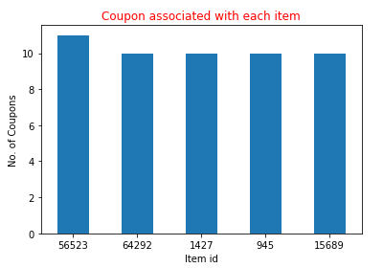
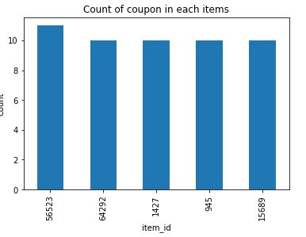
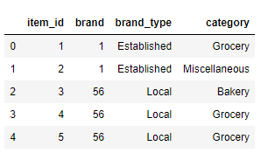
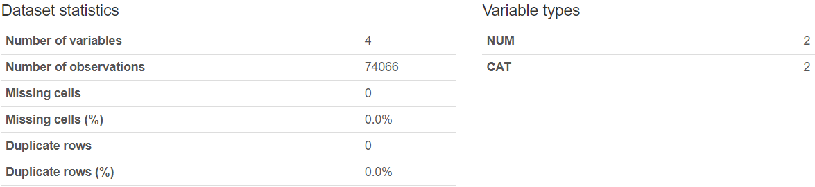
Univariate Analysis
4. Item data

Slide 8
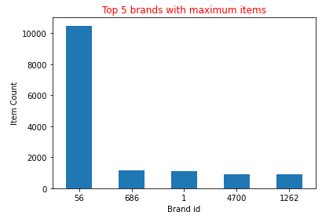
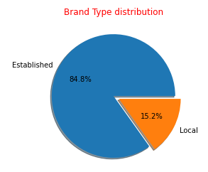
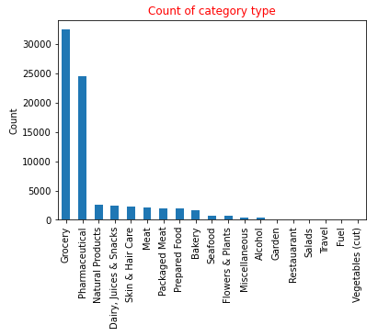
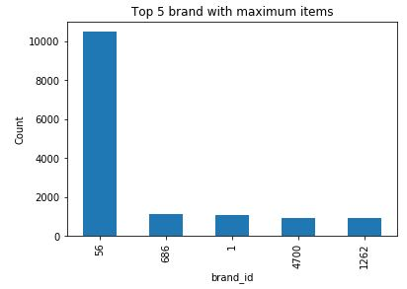
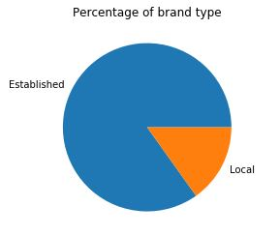
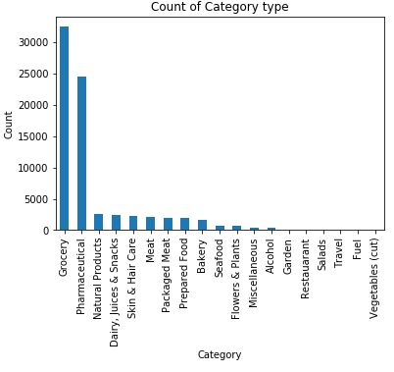
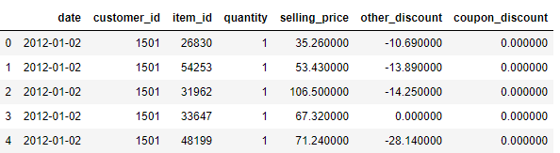
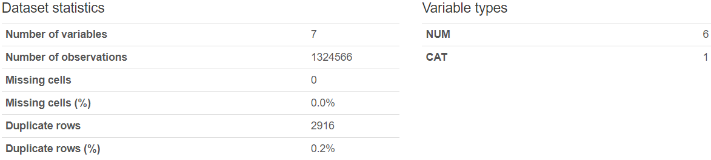
Univariate Analysis
5. Customer Transaction data

Slide 9
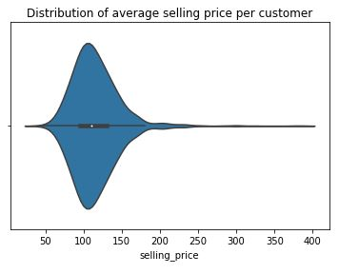
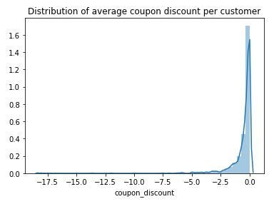
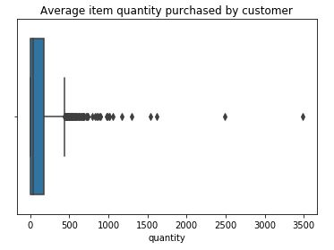
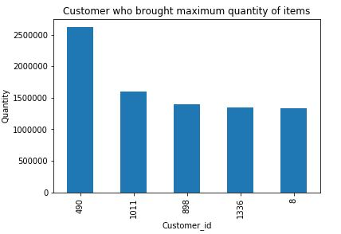
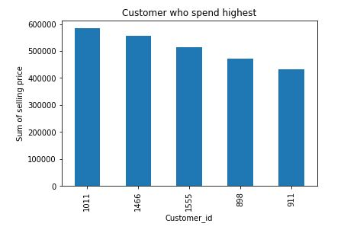
Univariate Analysis

Slide 10
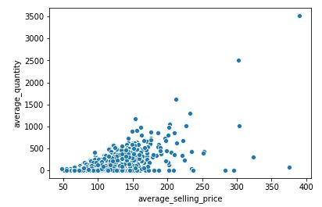
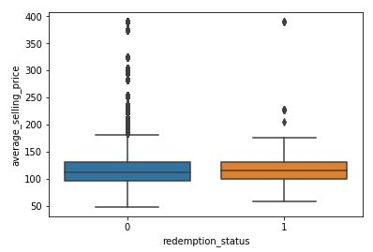
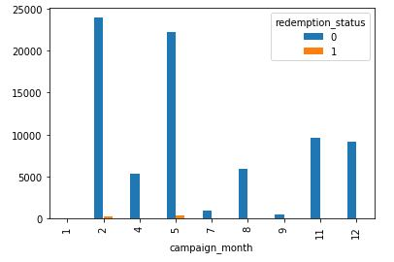
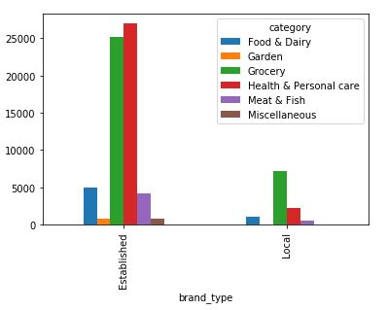
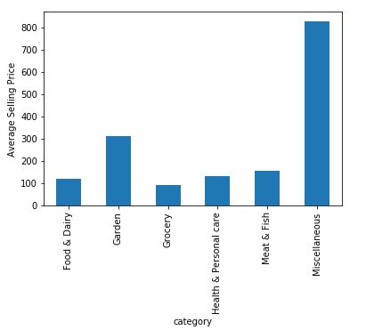
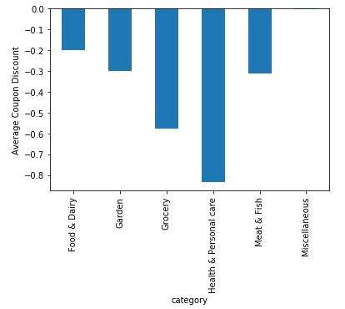
Bivariate Analysis

Slide 11
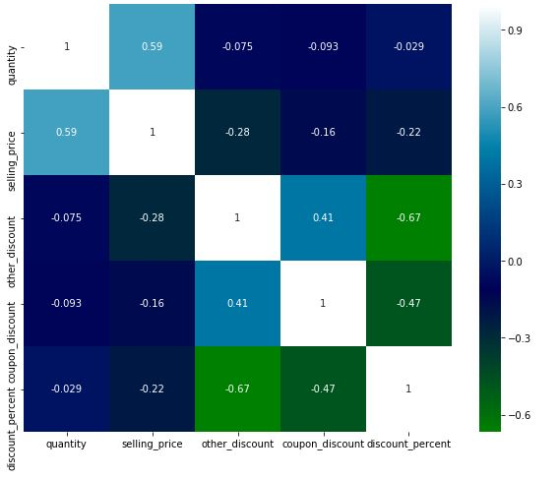
Multi Variate Analysis
Heatmap for customer transaction data

Slide 12
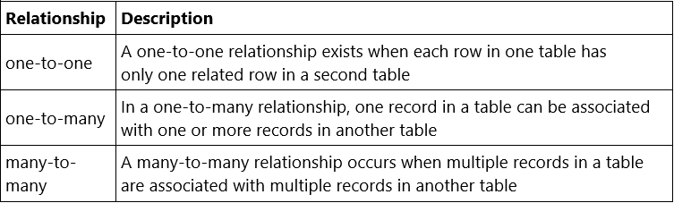


Merging Data
Types of Relationships
one to many
many to many

Slide 13
Merging steps
Creating train_campaign table with simple merge of train data and campaign data using campaign_id
Creating item_coupon_map table with simple merge of item data and coupon_item_mapping using item_id
Creating dummy columns for item_coupon_map categorical columns and then aggregating data with respect to coupon_id. Columns are aggregated using different functions like sum, count and nunique
Merging item_coupon_map table with train_campaign on coupon_id and creating new table train_camp_item_coupon_map
Aggregating customer transaction data with respect to customer_id using function like sum and count
Creating final table by merging aggregated customer transaction data with train_camp_item_coupon_map table on customer_id

Slide 14
FEATURE ENGINEERING
Sr No. | Existing Features | New Features
1. | start_date, end_date | campaign_period,campaign_year,campaign_month
2. | start_date, end_date | campaign_quarters
3. | item category | Grocery, Miscellaneous, Food &Garden, Health & Personal Care, Meat & Fish ,Garden
4. | selling_price,other_discount,coupon_discount | discount percent
5. | customer_id, coupon_id using train and campaign data | campaign_customer_nunique, campaign_coupon_nunique
6. | item_id, brand using item and coupon_item_mapping data | coupon_item_count , coupon_unique_brand
7. | item_id, date, group by transaction data | no_of_customer_visits, total_item_customer_purchased
8. | coupon_discount, group by transaction data | no_of_coupon_discount

Slide 15














MODEL EVALUATION
KNN Classifier Decision Tree Support Vector Machine
Random Forest Bagging KNN AdaBoost Gradient Boost

Slide 16


Important features
The diagrams above displays the top 10 important features of AdaBoost and Gradient Boost models.

Slide 17


In the above illustrations we have displayed the top 10 important features of decision tree and random forest models.

Slide 18


Model TUNING
Evaluation Metrics Before Hyperparameter Tuning
Evaluation Metrics After Hyperparameter Tuning

Slide 19


Visualization for MODEL SELECTION
Inference
After building different machine learning models and comparing their results through evaluation metrics we have found that the performance for Random Forest model would be the best if we select it as our final model.

Slide 20

Top Features of Final ML Model
Below are the top 10 important features of our final machine learning model - Random Forest.

Slide 21
Learnings & Business Interpretation
From our problem statement below are some of the questions that we have tried to answer and tried to understand on business.
Possible factors influencing customers to redeem coupon?
Which coupon is more popular among customers?
Which item has the highest probability for redemption?
Comparison of X & Y campaigns?
Impact of average coupon discount on redemption?
Suggestions to design a better promotional campaign?

Slide 22
THANK YOU!

